Slide 1
PHP / Laravel /Drupal Training

Slide 2
Introduction
Trainer 1: Vishal Patil Designation: Lead Software Architect
Trainer 2: Chirag Verma Designation: Senior Tech Lead

Slide 3
Overview – Day 1
Activity | Timing
PHP Basics | 10:30 to 11:30
Tea Break (11:30 to 11:45)
PHP Basics | 11: 45 to 13:00
Lunch Break (13:00 to 14:00)
Object Oriented Programming | 14:00 to 15:00
Break (15:00 to 15:15)
Design Patterns / SOLID Principles | 15:15 to 16:00
Break (16:00 to 16: 15)
Docker & Git | 16:15 to 17:00

Slide 4
Overview – Day 2
Activity | Timing
Laravel - Introduction | 10:30 to 11:30
Tea Break (11:30 to 11:45)
Laravel - CRUD | 11: 45 to 13:00
Lunch Break (13:00 to 14:00)
Laravel - User Access & Security | 14:00 to 15:00
Break (15:00 to 15:15)
Laravel - Third Party Package Integration | 15:15 to 16:00
Break (16:00 to 16: 15)
Laravel - Events, Notifications & Commands | 16:15 to 17:00

Slide 5
Overview – Day 3
Activity | Timing
Drupal - Introduction | 10:30 to 11:30
Tea Break (11:30 to 11:45)
Drupal - Entity Types and Entities | 11: 45 to 13:00
Lunch Break (13:00 to 14:00)
Drupal - Configuration, Modules, Themes | 14:00 to 15:00
Break (15:00 to 15:15)
Drupal - Views, Workflows & ECA | 15:15 to 16:00
Break (16:00 to 16: 15)
Drupal - Module and Theme Development | 16:15 to 17:00

Slide 6

PHP Basics
A popular general-purpose scripting language that is especially suited to web development.
Fast, flexible and pragmatic, PHP powers everything from your blog to the most popular websites in the world.
PHP (Hypertext Preprocessor) is a widely-used open-source scripting language.

Slide 7
Why PHP?
Easy to learn and widely used.
Supports databases like MySQL, PostgreSQL, and MongoDB.
Powers popular CMS platforms (WordPress, Drupal, Joomla).
Powers MVC frameworks like Laravel, Symphony

Slide 8
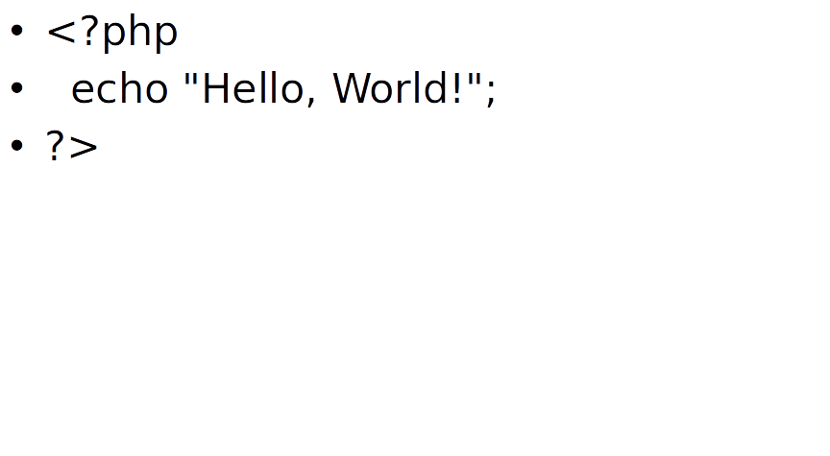
PHP Syntax Basics

Slide 9
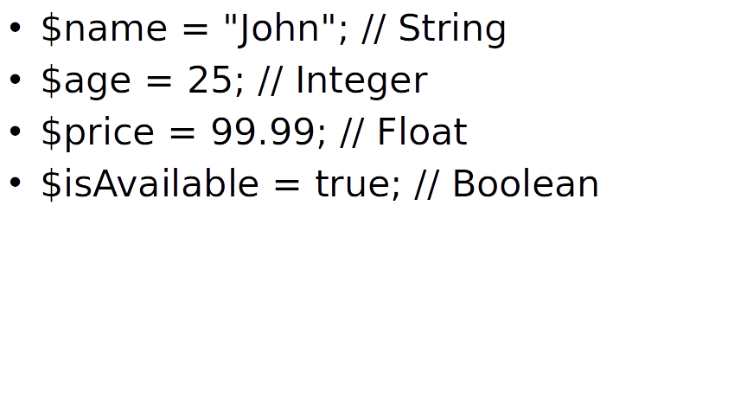
Variables & Data Types

Slide 10
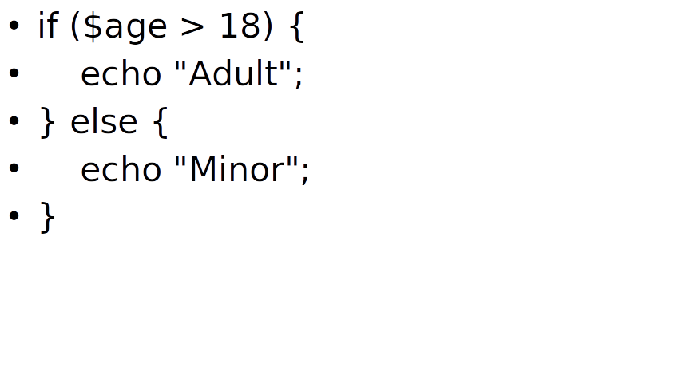
Control Structures

Slide 11
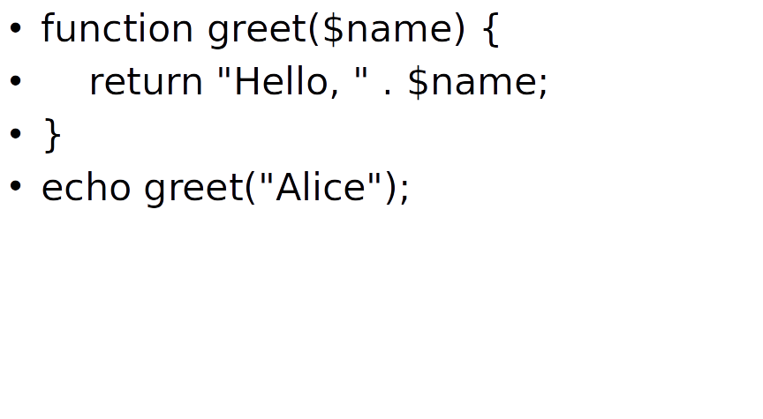
Functions

Slide 12
Working with Forms
<form method="POST">
<input type="text" name="username">
<input type="submit">
</form>
<?php
if ($_SERVER["REQUEST_METHOD"] == "POST") {
echo "Hello, " . $_POST["username"];
}?>

Slide 13
Connecting to MySQL
$conn = new mysqli("localhost", "user", "password", "database");
if ($conn->connect_error) {
die("Connection failed: " . $conn->connect_error);
}

Slide 14
Object Oriented Programming
A programming paradigm based on objects, which contain data and behavior.
Encapsulation
Bundling data and methods together.
Abstraction
Hiding complexity and exposing only essential details.
Inheritance
Reusing code by deriving new classes from existing ones.
Polymorphism
Using a single interface to represent multiple data types.
Benefits:
✅ Code reusability ✅ Scalability ✅ Maintainability ✅ Modularity

Slide 15
Design Patterns / SOLID Principles
Design Patterns A design pattern is a reusable solution to a common problem in software design. It's a high-level description of how to solve a problem and can be used as a template to create a solution for a specific program.
Solid Principles SOLID principles are a set of five design guidelines aimed at making software designs more understandable, flexible, and maintainable. These principles are widely used in object-oriented programming, although they can also be applied in other paradigms.

Slide 16
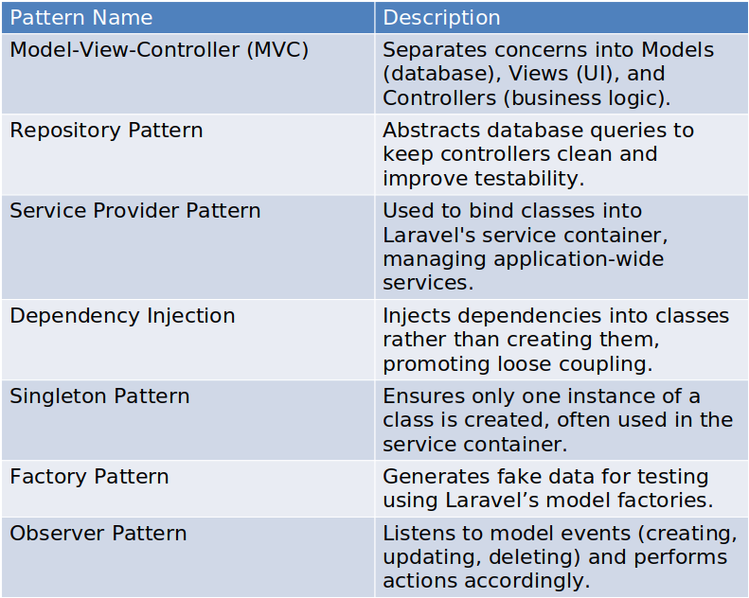
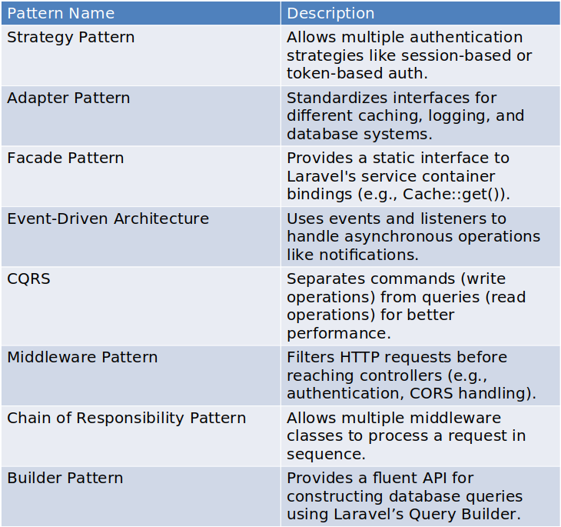
Design Patterns

Slide 17
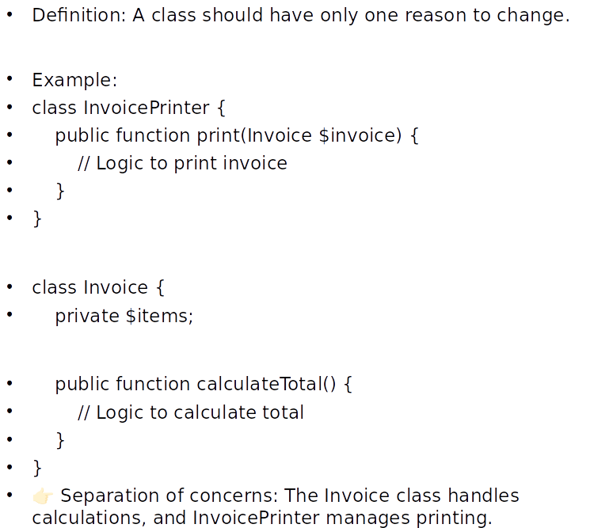
SOLID - Single Responsibility Principle (SRP)

Slide 18
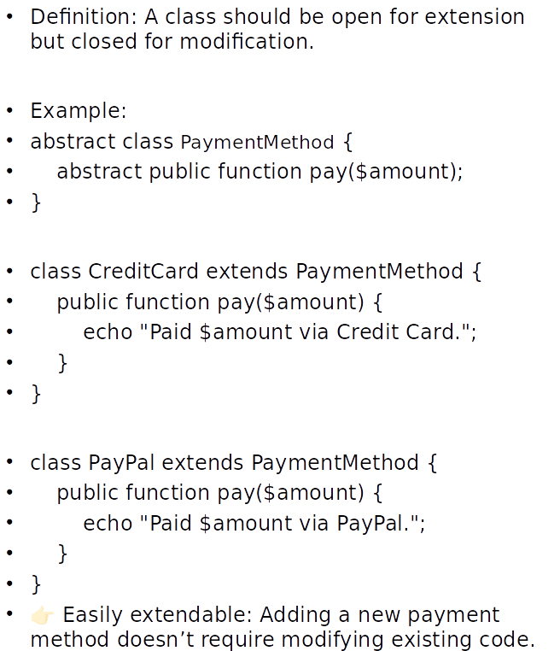
SOLID - Open/Closed Principle (OCP)

Slide 19
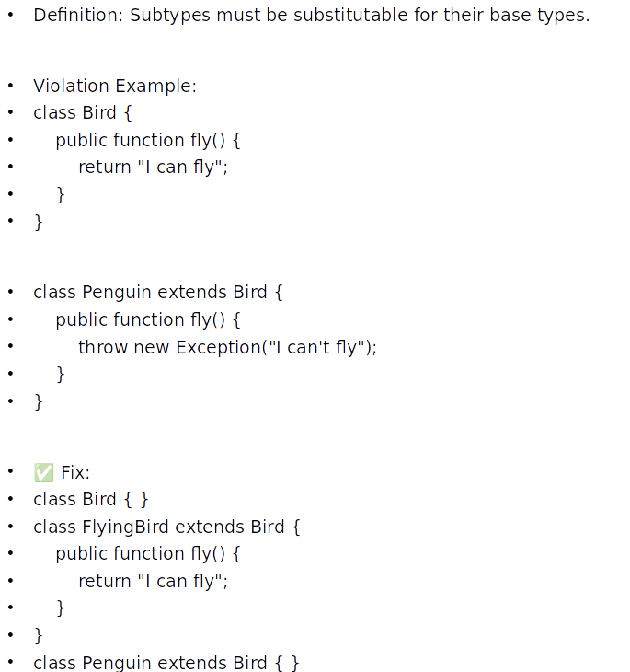
SOLID - Liskov Substitution Principle (LSP)

Slide 20
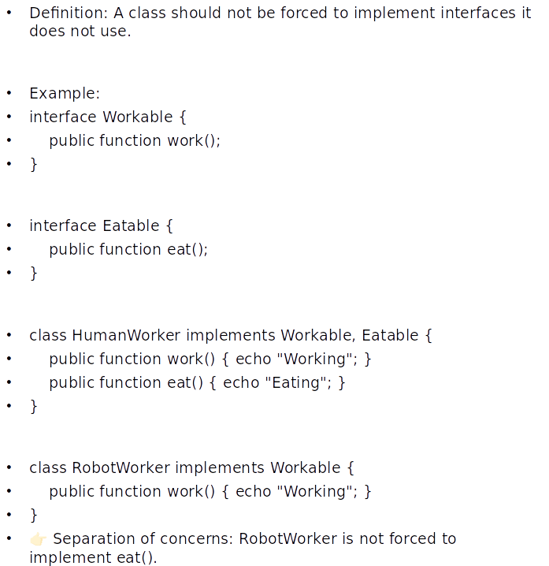
SOLID - Interface Segregation Principle (ISP)

Slide 21
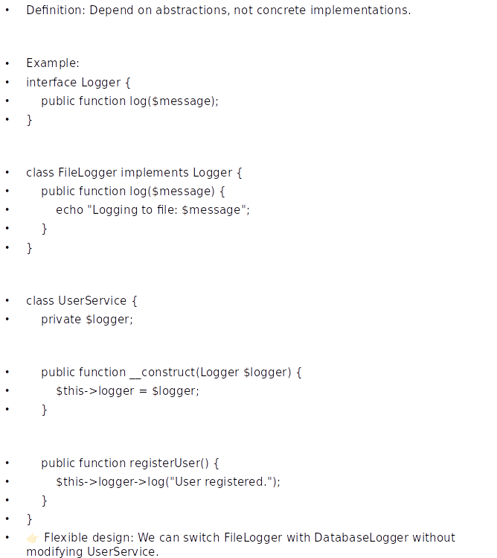
SOLID - Dependency Inversion Principle (DIP)

Slide 22
Docker & Git
🚀 Docker: Containerization Simplified
What is Docker?
A platform for developing, shipping, and running applications in containers.
Key Benefits:
Portability – Runs anywhere (local, cloud, on-prem).
Scalability – Easily scale applications.
Consistency – Works across different environments.
Core Concepts:
Image: A lightweight, standalone package with everything needed to run a piece of software.
Container: A running instance of an image.
Dockerfile: Script to define and build Docker images.
Docker Compose: Tool to define multi-container applications.
🐙 Git: Version Control Made Easy
What is Git?
A distributed version control system to track changes in source code.
Key Benefits:
Collaboration – Work seamlessly in teams.
Versioning – Roll back to previous versions anytime.
Branching – Experiment without affecting the main codebase.
Common Commands:
git init – Initialize a repository
git clone <repo> – Clone a repository
git add . – Stage changes
git commit -m "message" – Commit changes
git push origin <branch> – Push to remote

Slide 23
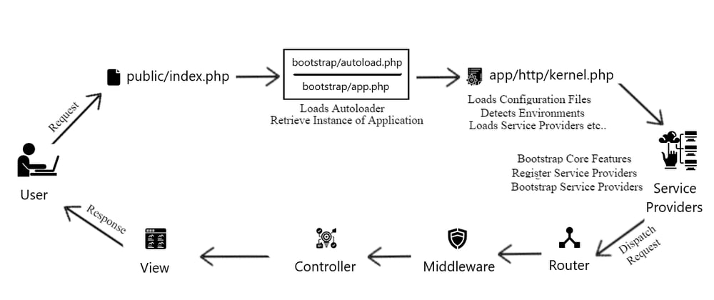
Laravel - Introduction
Laravel is a PHP framework for web application development.
Follows MVC (Model-View-Controller) architecture.
Provides elegant syntax and built-in features to enhance productivity.
MVC Architecture in Laravel
Model: Manages database interactions.
View: Handles user interface.
Controller: Processes user requests and connects Model & View.

Slide 24
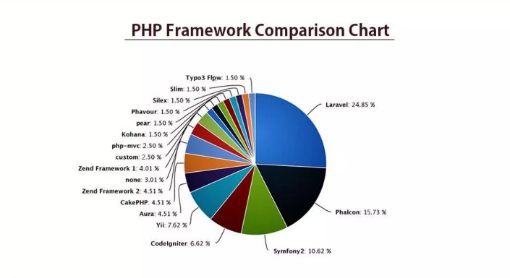
Why Choose Laravel?
Simple and expressive syntax.
Built-in authentication and authorization.
Eloquent ORM for database management.
Query Builder – Help you create secured SQL Queries
Blade templating engine for views.
Middleware for request filtering.
Setting Up Laravel
Prerequisites: PHP, Composer, MySQL ,Apache2/Nginx
Installation: composer create-project --prefer-dist laravel/laravel project_name
Setup .env file
Running the application: php artisan serve

Slide 25
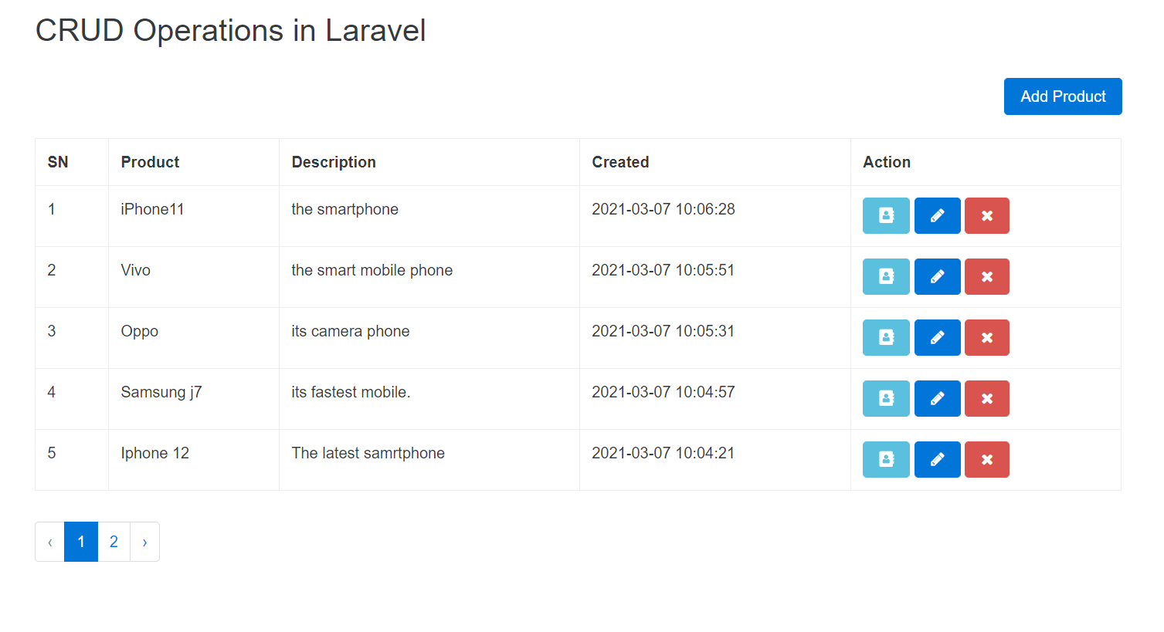
Laravel - CRUD
Create (Store Data):​
Example: Post::create(['title' => 'New Post', 'content' => 'Post content']);​
Using a Controller: public function store(Request $request) {...}​
​
Read (Retrieve Data):​
Example: Post::all(); or Post::find($id);​
​
Update Data:​
Example: $post = Post::find($id); $post->update(['title' => 'Updated Title']);​
​
Delete Data:​
Example: $post = Post::find($id); $post->delete();​

Slide 26
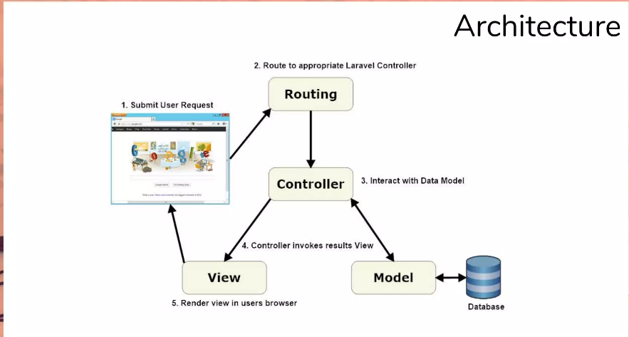
Laravel Routes, Model & Controller
Routing
Routes define URL structure.
Route parameters and named routes.
The most basic Laravel routes accept a URI and a closure, providing a very simple and expressive method of defining routes and behavior without complicated routing configuration files:
Model
Each Data table has its own Model, You can use the model to Create ,Read ,Update and Delete row from specific table.
Controller
Controller is responsible for controlling the application logic and acts as the coordinator between the View and Model . The Controller receives input from the users via the View, then process the users's data with the help of Model and passing the results back to the view.

Slide 27
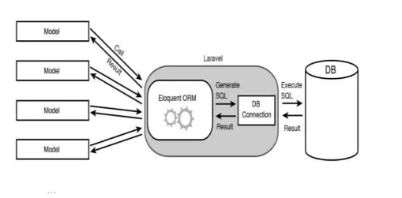
Eloquent Model Methods
Model::create(array("key"=>"value"));
Model::update(array("key"=>"value"));
Model::delete();
Model::all();
Model::find(1);
Model::findOrFail(1);
Model::where('foo','=','bar')->get();
Model::where('foo','=','bar')->first();
Model::where('foo','=','bar')->update();
Model::where('foo','=','bar')->delete();
Model::where('foo','=','bar')->findOrFail();
Model::where('foo','=','bar')->count();
Model::with('relation')->get();
Model::all()->take(10);
Model::all()->skip(10);

Slide 28
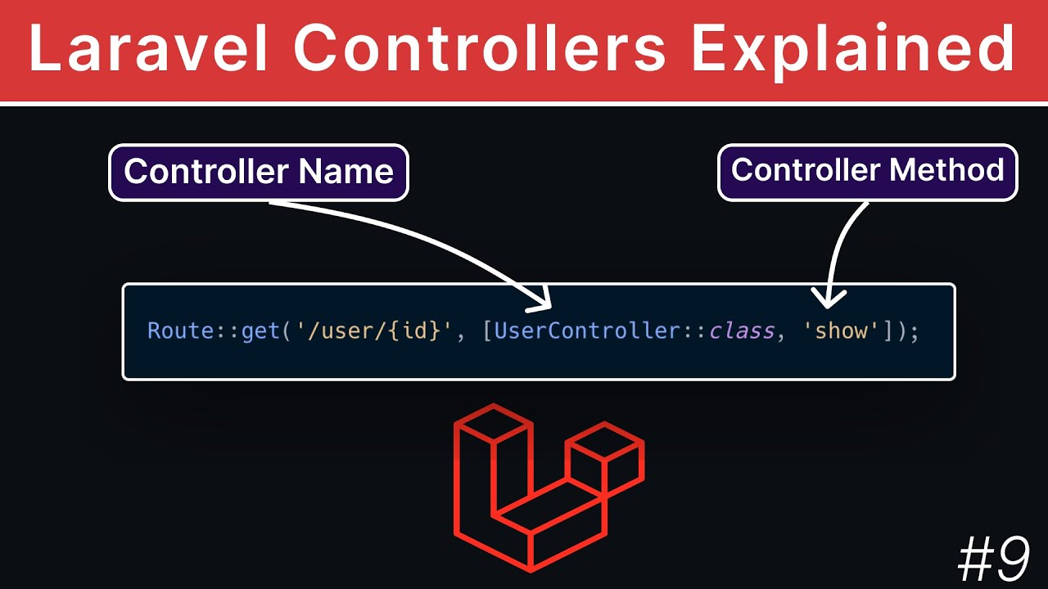
Understanding Controller & Resource Controller
Index: Display a listing of the resource.​
Create: show the form for creating a new resource.​
Store: Store a newly created resource in the storage.​
Show: Display the specific resource.​
Edit: Show the form for editing the specified resource.​
Update: Update the specific resource in the storage.​
Delete: Delete the specific resource in the storage.​
​

Slide 29
Laravel – Query Builder
Laravel Query Builder is a powerful tool for interacting with your database using an expressive and fluent syntax. It allows you to construct complex SQL queries without writing raw SQL. Below are some commonly used Query Builder methods:
Basic Queries
Fetching Data:
DB::table('users')->get();
DB::table('users')->select('name', 'email')->get();
Filtering Data:
DB::table('users')->where('status', 'active')->get();
DB::table('users')->whereBetween('age', [18, 40])->get();
Inner Join:
DB::table('users')->join('orders', 'users.id', '=', 'orders.user_id')->get();
Left Join:
DB::table('users')->leftJoin('orders', 'users.id', '=', 'orders.user_id')->get();
Ordering:
DB::table('users')->orderBy('created_at', 'desc')->get();
Limiting:
DB::table('users')->limit(10)->get();
DB::table('users')->skip(5)->take(10)->get();
Aggregates:
DB::table('users')->count();
DB::table('orders')->max('price');
DB::table('sales')->sum('amount');
DB::table('products')->avg('price');
Inserting Data:
DB::table('users')->insert([
'name' => 'John Doe',
'email' => 'john@example.com',
'password' => bcrypt('secret')
]);
Insert & Get ID:
DB::table('users')->insertGetId([...]);
Updating:
DB::table('users')->where('id', 1)->update(['name' => 'Updated Name']);
Deleting:
DB::table('users')->where('id', 1)->delete();
DB::table('users')->truncate();
Raw Queries
DB::select('SELECT * FROM users WHERE status = ?', ['active']);
DB::insert('INSERT INTO users (name, email) VALUES (?, ?)', ['John Doe', 'john@example.com']);
DB::update('UPDATE users SET status = ? WHERE id = ?', ['inactive', 1]);
DB::delete('DELETE FROM users WHERE id = ?', [1]);

Slide 30
Laravel – Artisan
Artisan is the command line interface included with Laravel. Artisan exists at the root of your application as the artisan script and provides a number of helpful commands that can assist you while you build your application.
Uses the Symphony Console component
Manage table migrations ,seed tables, create resourceful controllers and many more
Developers best friend!
Laravel – Service Providers
Act like a component bootstrap.
Group related IoC registrations in one place.
Can Also run other functionalities like artisan commands.
Laravel – Facades
Provide static interfaces to classes
Classes are resolved via IoC Containers
Laravel is full with facades such as View, Cache , Config and Others.

Slide 31
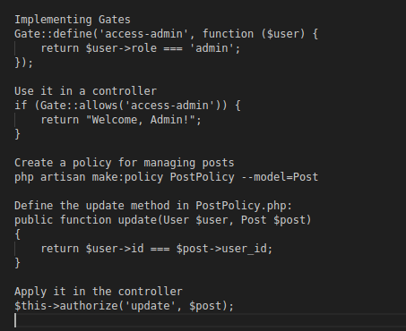
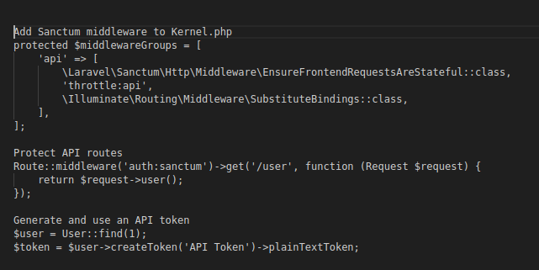
Laravel - User Access & Security
- Laravel provides built-in authentication
- Supports Breeze, Jetstream, and Fortify
- Easy integration for login & registration
Laravel Authorization (Roles & Permissions)
- Gates: Handle simple authorization
- Policies: Manage model-based permissions
- Spatie Laravel Permission: Easy Role-Based
Access Control (RBAC)
Secure API Authentication with Laravel Sanctum
- Laravel Sanctum allows API authentication
- Uses token-based authentication
- Protects API routes from unauthorized access

Slide 32
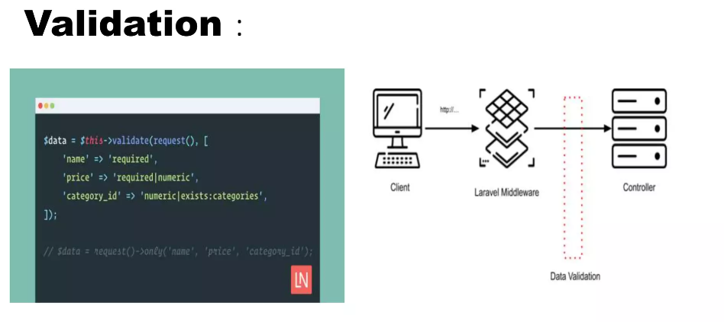
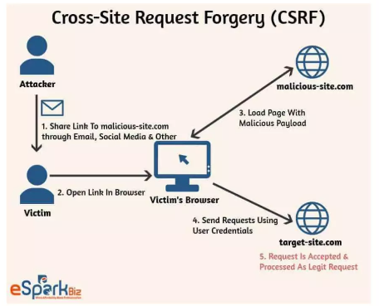
Laravel - User Access & Security
Security Best Practices in Laravel
- Enable CSRF protection
- Implement Rate Limiting
- Secure password hashing & encryption
- Validate and sanitize file uploads
Logging & Monitoring Security Events
- Log authentication attempts
- Detect and prevent suspicious activity
- Send email alerts for failed login attempts

Slide 33
Laravel - Third Party Package Integration
- Laravel supports third-party packages to extend functionality
- Packages can provide authentication, logging, payments, and more
- Installed via Composer
Installing a Package via Composer
Run: composer require vendor/package-name
- Laravel automatically loads packages via Service Providers
Configuring a Package
- Many packages require publishing config files
- Run: php artisan vendor:publish --tag=package-tag
- Modify configuration in config/package.php
Example: Spatie Laravel Permissions
composer require spatie/laravel-permission
Run migrations: php artisan migrate
Assign roles and permissions to users
Best Practices for Using Packages
- Check package compatibility with your Laravel version
- Regularly update dependencies
- Review package documentation before installation

Slide 34
Laravel - Events, Notifications & Commands
- **Events**: Handle system-wide occurrences
- **Notifications**: Send alerts to users via email, SMS, etc.
- **Commands**: Automate tasks using Artisan commands
Laravel Events
1. Create an event: php artisan make:event UserRegistered
2. Create a listener: php artisan make:listener SendWelcomeEmail --event=UserRegistered
3. Register in EventServiceProvider and trigger with event(new UserRegistered($user));
Laravel Notifications
1. Create a notification: php artisan make:notification UserWelcome
2. Define channels (mail, SMS, database)
3. Send notification: $user->notify(new UserWelcome());
Laravel Commands
1. Create a command: php artisan make:command SendReport
2. Define logic in handle() method
3. Schedule execution in Kernel.php
Best Practices
- Use queues for async execution
- Optimize notification channels
- Regularly clean up stored notifications

Slide 35
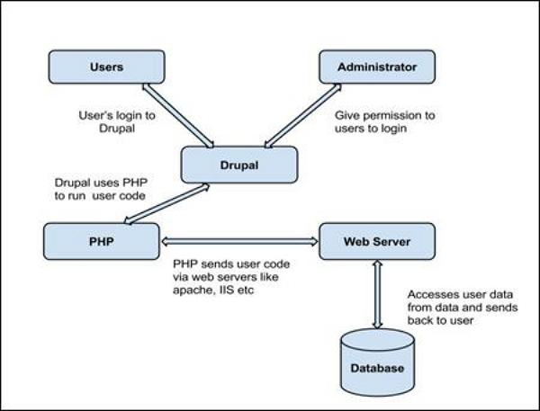

Drupal - Introduction
Introduction
Drupal is a powerful, open-source content management framework that provides unmatched flexibility for building everything from simple websites to complex web applications. With a vast ecosystem of free modules and themes, Drupal enables businesses, organizations, and developers to create scalable and highly customizable digital experiences. Whether you're looking to grow your brand, engage your audience, or build an interactive online community, Drupal offers the tools and flexibility to achieve your goals.

Slide 36
Drupal – Why Choose Drupal?
Open-Source & Extensible
Drupal is free and open-source, backed by a strong global community. Its modular architecture allows for endless customization, ensuring your website or application can evolve with your needs.
Scalability & Performance
Drupal grows as you grow. Whether you’re running a small business website or a large enterprise platform, Drupal’s robust architecture ensures high performance and scalability.
Multilingual & Accessible
With built-in multilingual and accessibility features, Drupal empowers you to reach a global audience and ensure an inclusive user experience for all visitors.
Flexibility & Customization
Drupal’s flexible design enables seamless integration with third-party tools and hosting services, allowing you to build, deploy, and manage applications on various platforms with ease.
Empowering Content Creators & Marketers
The latest Drupal CMS puts advanced tools in the hands of marketers, web designers, and content creators, enabling them to craft exceptional digital experiences without extensive technical knowledge.

Slide 37
Drupal - Entity Types and Entities
An entity in Drupal is a container for data, similar to a database record. Each entity can have multiple fields, making it a highly flexible and reusable component within a Drupal application. Entities can be customized and extended to fit specific project requirements.
Content Entities
These entities store user-generated content and are fieldable, meaning they can have custom fields.
Examples:
Nodes (Content types like Articles, Pages)
Taxonomy Terms (Categorization of content)
Users (User profiles)
Media (Images, videos, and other media types)
Comments (User-generated comments on content)
Config Entities
These entities store site configuration settings and are typically managed through the administrative interface.
Examples:
Content Types (Definitions for node structures)
Views (Stored queries and display configurations)
Roles & Permissions (User access management)
Block Layouts (Placement of UI components)

Slide 38
Drupal - Configuration, Modules, Themes
Drupal’s architecture is highly flexible and modular, enabling users to configure their websites, extend functionality with modules, and customize the appearance using themes. Understanding how configuration, modules, and themes work together is essential for building and managing a Drupal-powered website effectively.
Configurations
Modules
Themes
Drupal

Slide 39
Drupal - Configuration
Drupal provides a Configuration Management System to store and manage settings related to the site, content structure, and functionality.
Types of Configuration
Simple Configuration: Stores basic settings such as site name, email, and caching settings.
Configuration Entities: Includes more complex configurations such as content types, views, menus, and permissions.
Configuration Synchronization: Drupal allows exporting and importing configurations using YAML files, making it easy to move settings between development, staging, and production environments.

Slide 40
Drupal - Modules
Modules extend Drupal’s core functionality by adding new features. Drupal provides Core Modules, Contributed Modules, and Custom Modules to enhance website capabilities.​
Types of Modules
Core Modules: Included with Drupal by default (e.g., Views, Taxonomy, User, Block).
Contributed Modules: Developed by the Drupal community and available on Drupal.org (e.g., Pathauto, Webform, Devel).
Custom Modules: Developed specifically for a project’s unique requirements.
How to Install a Module?​
Download the module using Composer:
composer require drupal/module_name
Enable the module using Drush :
drush en module_name -y
Configure the module in the Extend section of the Drupal admin panel.

Slide 41
Drupal - Themes
Themes control the look and feel of a Drupal site, defining layout, typography, colors, and overall user experience.​
Types of Themes
Core Themes: Default themes included with Drupal (e.g., Olivero, Claro).
Contributed Themes: Community-created themes available on Drupal.org.
Custom Themes: Designed and developed for specific projects.
How to Install a Theme?
Download the theme using Composer:
composer require drupal/theme_name
Enable the theme:
drush theme:enable theme_name
Set it as the default theme:
drush config:set system.theme default theme_name -y
Configure the theme in the Appearance section of the Drupal admin panel.

Slide 42
Drupal - Module and Theme Development
🔹 Steps to Develop a Custom Module
Create Module Directory
modules/custom/my_module
Define Module Metadata
my_module.info.yml
Implement Hooks & Services
my_module.module (hooks)
my_module.services.yml (dependency injection)
Routing & Controllers
my_module.routing.yml
src/Controller/MyController.php
Forms & Configuration
src/Form/MyForm.php
Use ConfigFactoryInterface for settings
🔹 Understanding Themes
Control the look and feel of a Drupal site
Can be custom or contributed
🔹 Steps to Develop a Custom Theme
Create Theme Directory
themes/custom/my_theme
Define Theme Metadata
my_theme.info.yml (name, libraries, regions)
Add Styles & Scripts
my_theme.libraries.yml (CSS, JS)
Create Twig Templates
Override core templates in templates/
Example: page.html.twig, node.html.twig
Define Theme Regions
Customize my_theme.info.yml
Customize Using Preprocessors
my_theme.theme (PHP preprocess functions)

